Slide 1
Liver Cirrihosis
Depi project

Slide 2
outline
Introduction
Dataset exploration
Data cleaning and preprocessing
EDA
Modeling

Slide 3
Introduction
Predicting the level of liver cirrhosis of a patient.
liver cirrhosis is critical sick because it can lead to death or in more lucky situations a liver transplant could make the patient survive.

Slide 4
Dataset exploration
N_Days: Number of days the patient has been in diagnosed
Status: Health status or outcome (target).
Drug: Medications or treatments the patient is receiving.
Age: Age of the patient in days.
Sex: Gender of the patient.
Ascites: Fluid buildup in the abdomen (Y, N).
Hepatomegaly: Enlargement of the liver (Y, N).
Spiders: Spider-like blood vessels on the skin (Y, N).
Edema: Swelling of the body (Y, N).
Bilirubin: Level of bilirubin in the blood, a key indicator of liver function.

Slide 5
Cont.
Cholesterol: Cholesterol levels.
Albumin: A protein produced by the liver, a marker for liver function.
Copper: Copper level in the blood, relevant for liver conditions.
Alk_Phos: Alkaline phosphatase, an enzyme related to liver function.
SGOT: Serum Glutamic-Oxaloacetic Transaminase, an enzyme that indicates liver health.
Triglycerides: Type of fat in the blood.
Platelets: Platelet count, related to blood clotting and liver function.
Prothrombin: A clotting factor, also linked to liver function.
Stage: Stage of liver cirrhosis (e.g., early stage, advanced).

Slide 6
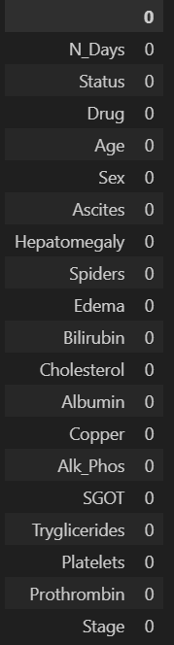
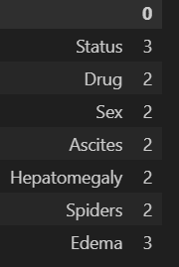
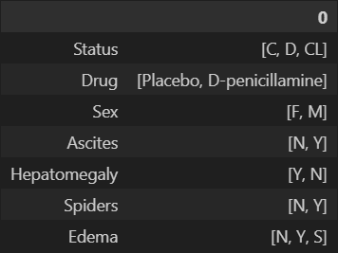
Data cleaning and preprcessing
Check missing values: there isn’t any
Check dublicates there is 15361 rows and drop them
How many unique values in categorical data. It tells how many dummy variable it needs to encode
Transforming age from days to years
What is the unique values of the categorical columns to know whether it has (?, none, etc) that cant be shown using isnull().sum()

Slide 7
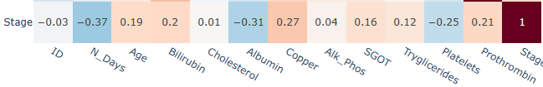
Weak correlation for all
Except for n_days, albumin, copper, paltelets it med
n_days are negative due to alonger u stay the more likely u will note survive

Slide 8
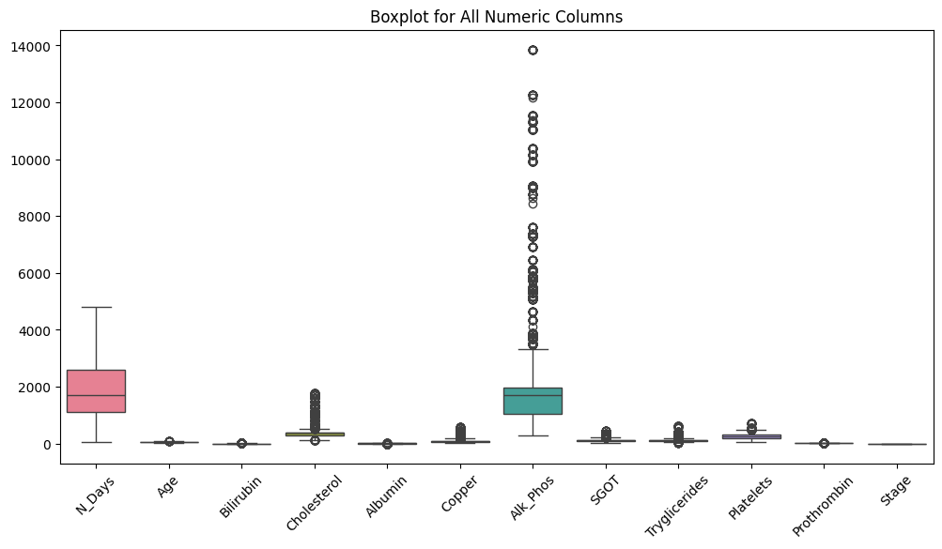
Eda
It shows outliers in ALK_Phos, Cholesterol, Tryglicenrides, Platelets, Sgot descending ordered

Slide 9
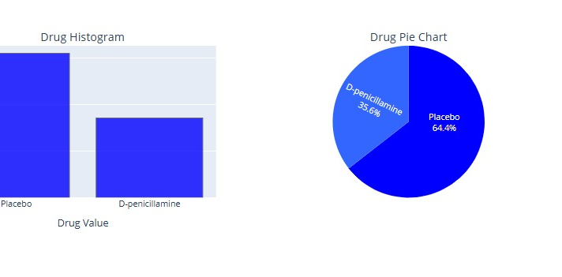
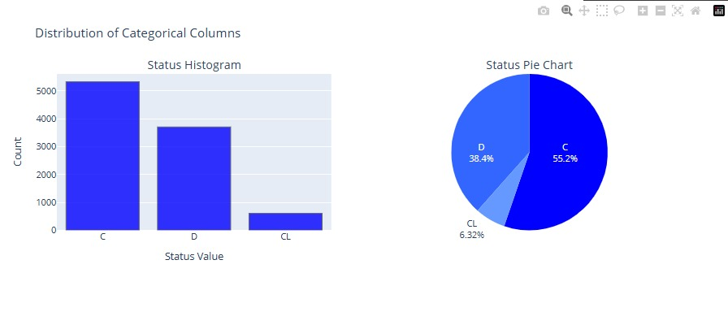
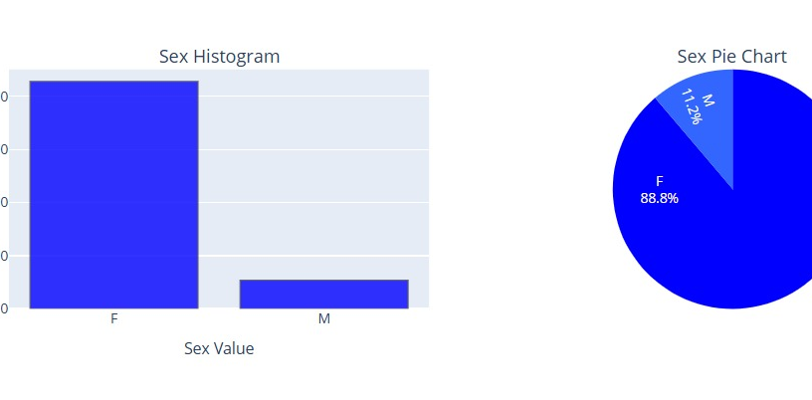
Distribution of the columns
There is a bias in the data that’s a problem need to be solved
Most of the dataset is females

Slide 10
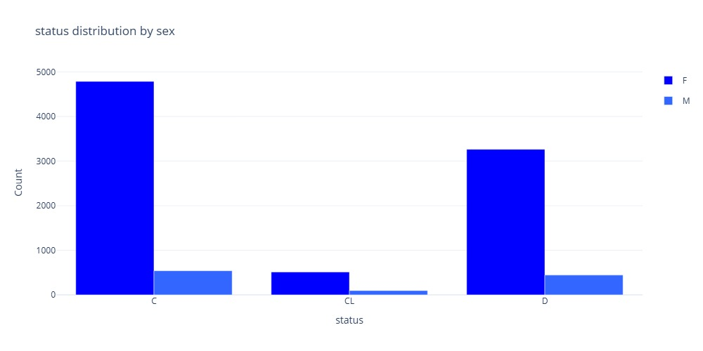
Most of the dataset is females that’s a normal conclusion

Slide 11
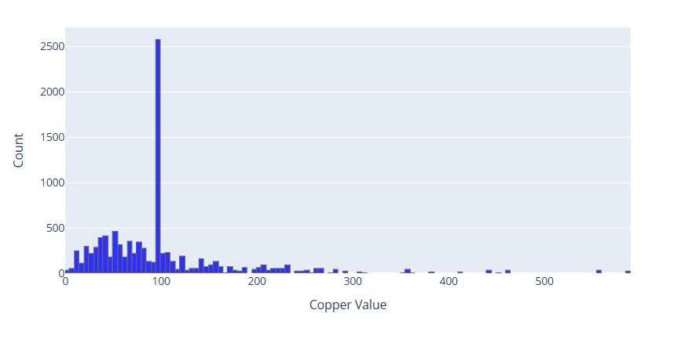
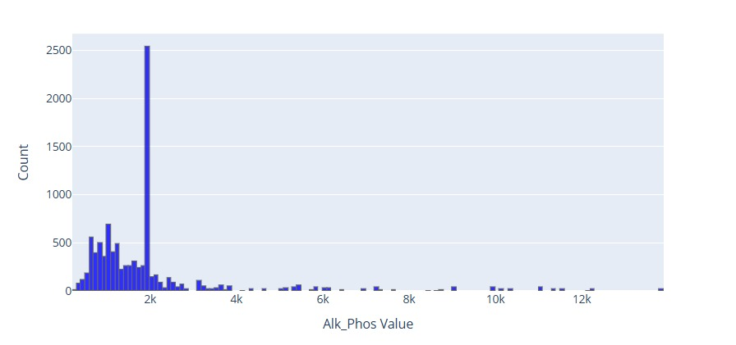
the outliers is visualized more here
There is a lot of rows have 100 value copper column
And I alk_phose also 2k has a lot of rows
That could make the model biased to these values

Slide 12
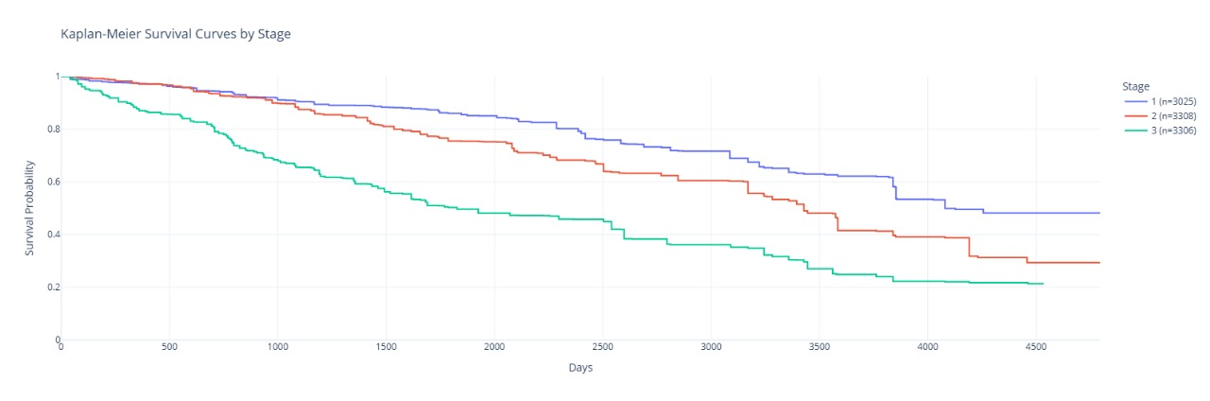
The probability of survive based on the stage
Patients in stage 3 unfortunately his liver condition is deteriorating rapidly.
Patients in stage 1 are more lucky has higher survive probability
Stage 2 patients if they diagnosed early could have better chance of survive

Slide 13
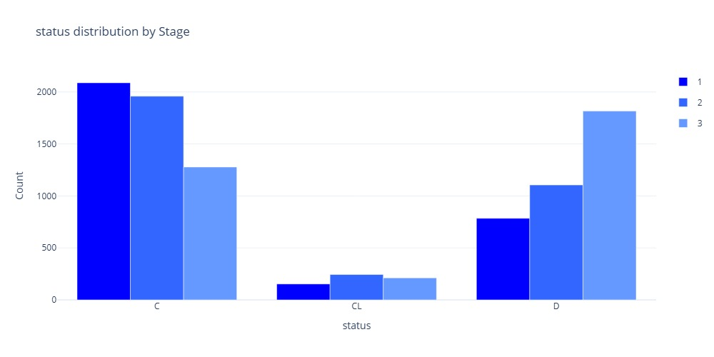
The class cl has lower distribution that could make the model ignored it or predicted wrong
But most of the patient in class C are in stage 1 then 2 then 3
On other hand in class D most of the patient in stage 3 then 2 then 1
However class cl the most is 2 then 3 then 1
We can say the patient in class c has higher probability of survive

Slide 14
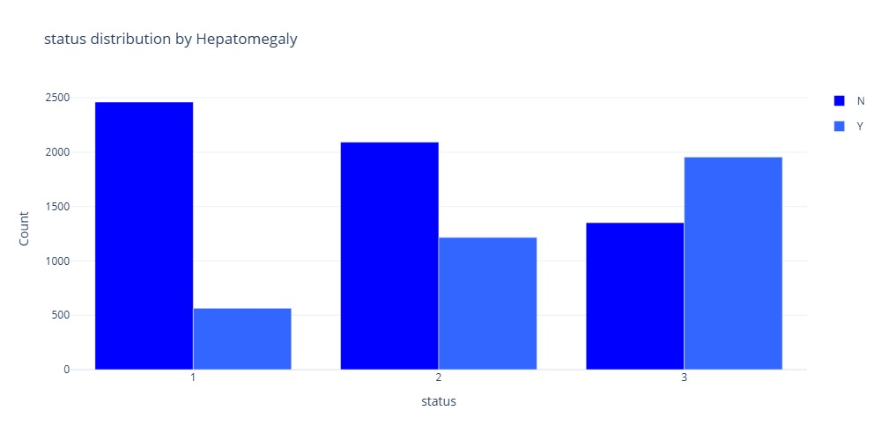
We can say if the patient
At statues 1 most likely he doesn't have hepatomegaly.
At status 2 he might doesn’t have it
At statues 3 more likely he/she has it
The odds he doesn’t have could means he has better chances of survive

Slide 15
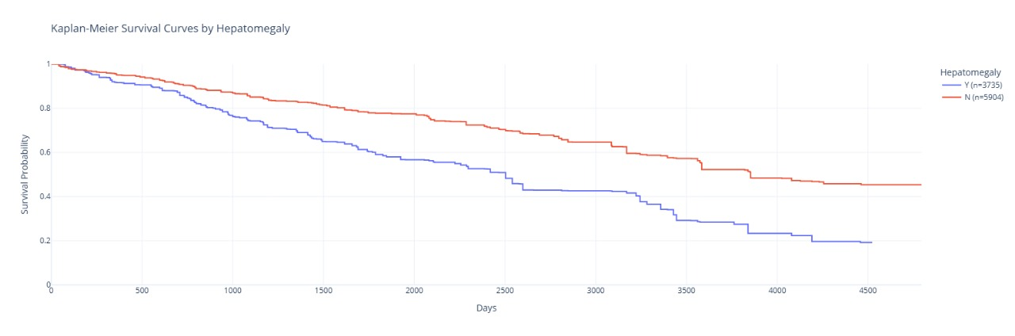
In the graph shown that doesn’t have hepatomegaly makes the patient have higher chances

Slide 16
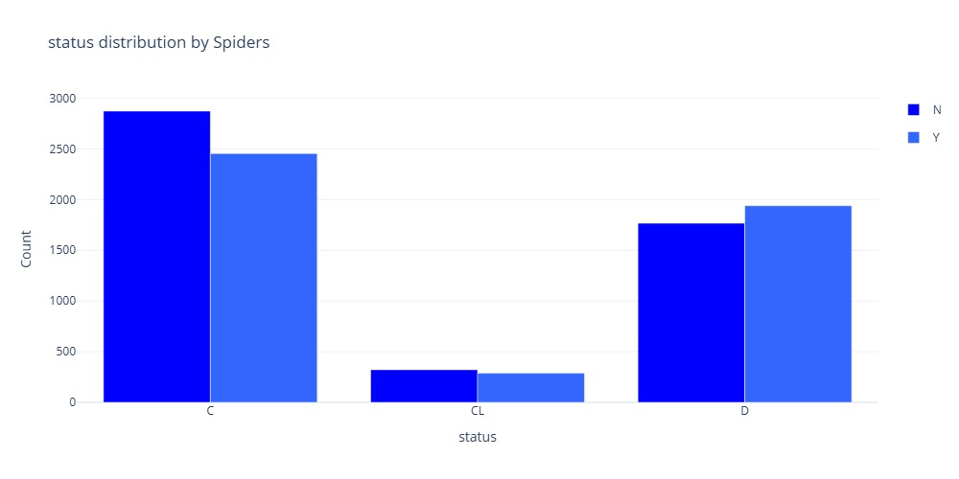
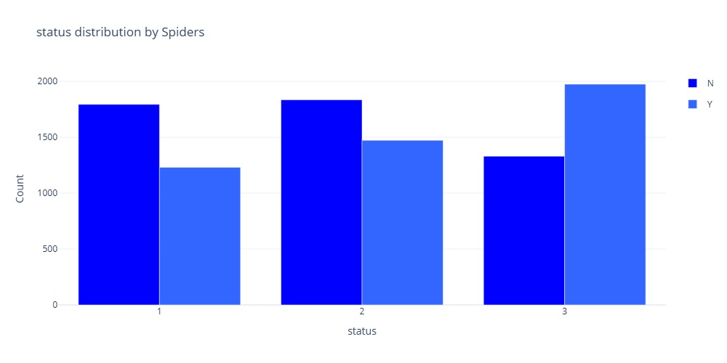
The diagnoses of status 3 is spider vains
If the patient stated to notice a vaues that’s mean he is stage 2
Stage 1 doesn’t appear most likely

Slide 17
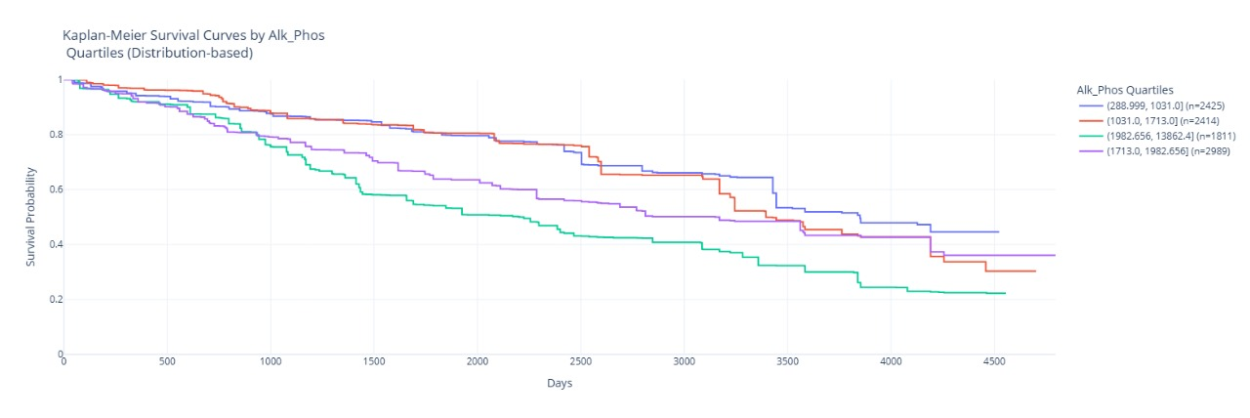
Its look like a normal chars have Alkaline phosphatase, (an enzyme related to liver function) having a lot of it could cause death like any other enzymes in your body

Slide 18
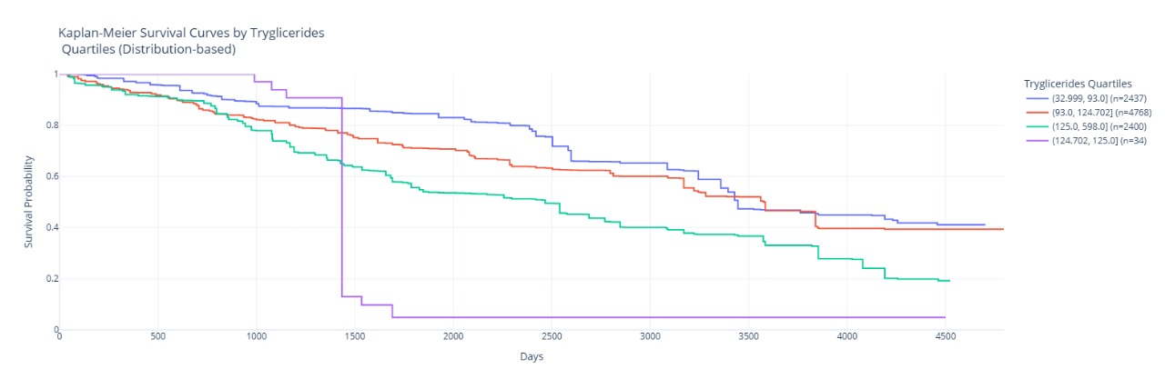
The look more scary for having abnormal amount of this type of fat in the blood. the first 1400 days u will be normal and better than normal with less death probability but at one moment you are dead (Rip)

Slide 19
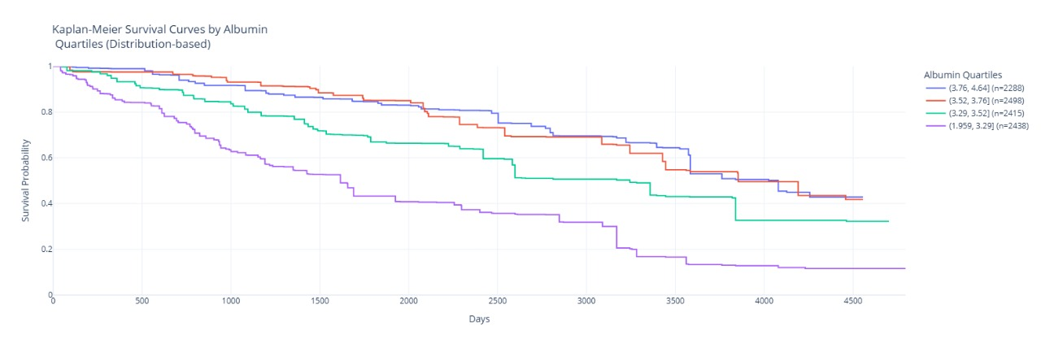
Having a lot of this protein it could lead to death

Slide 20
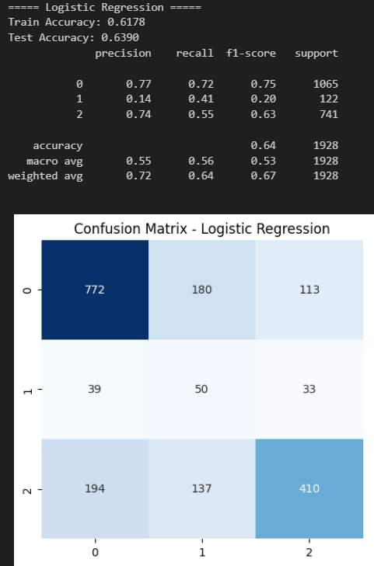
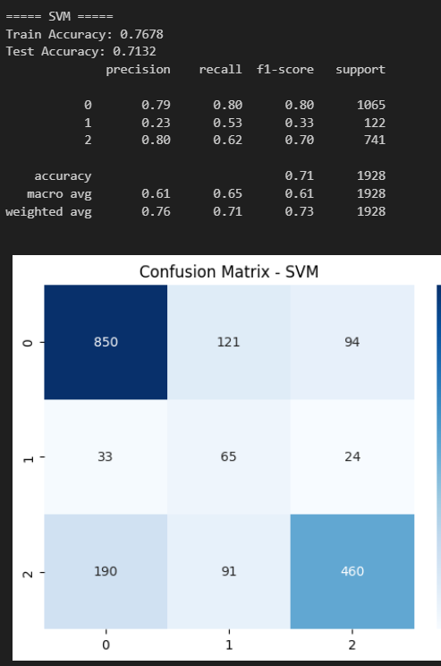
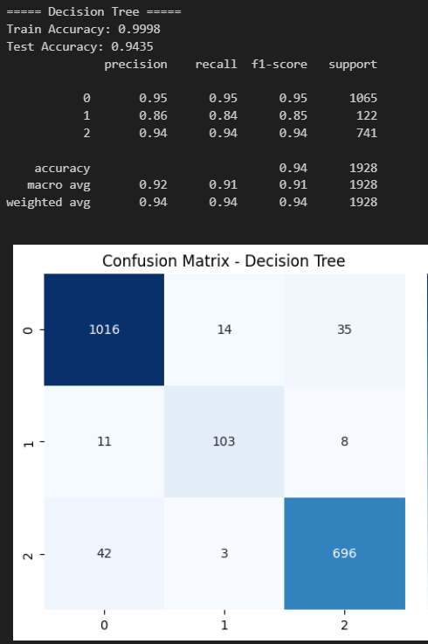
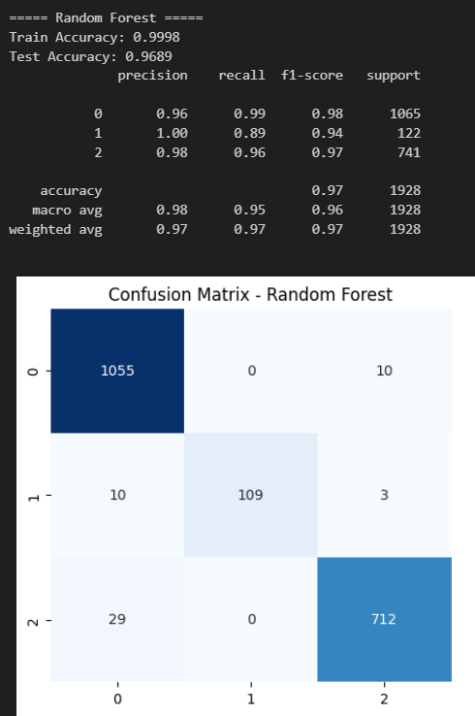
Modeling
Traditional learning
Random forest has the best performance
Decision tree has a little bit of overfitting
Logistic is the worest

Slide 21
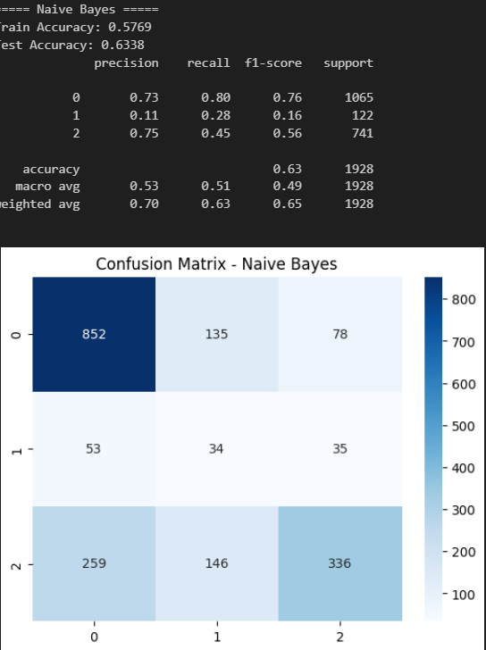
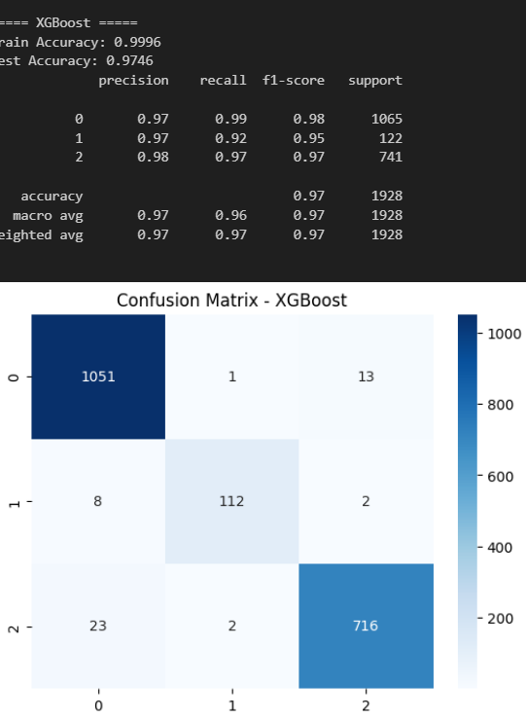
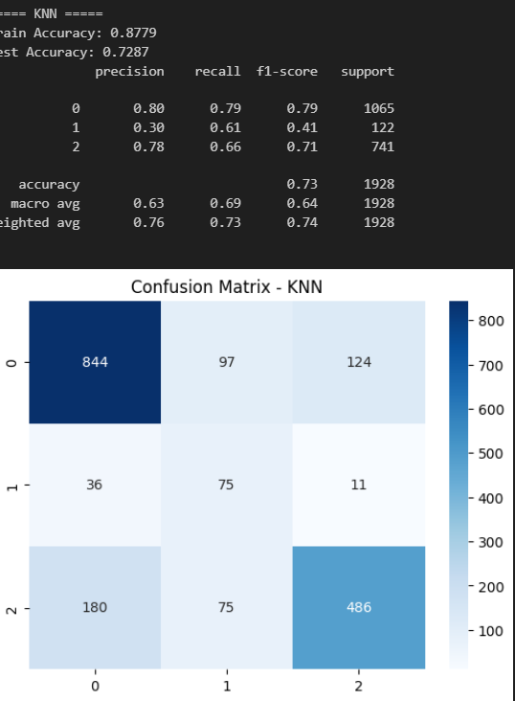
1. Best Model: XGBoost
Test Accuracy: 0.9746
Precision, Recall, F1: High across all classes, with a weighted F1 of 0.97.
Conclusion: Excellent performance overall.
2. Second Best: Knn
Test Accuracy: 0.7287
Precision, Recall, F1: Balanced, but struggles with Class 1 (low precision, moderate recall).
Conclusion: Decent but can be improved.
3. Third: Naïve bayes
Test Accuracy: 0.6338
Precision, Recall, F1: Very low performance for Class 1, with a macro F1 of 0.49.
Conclusion: Needs significant improvement.

Slide 22
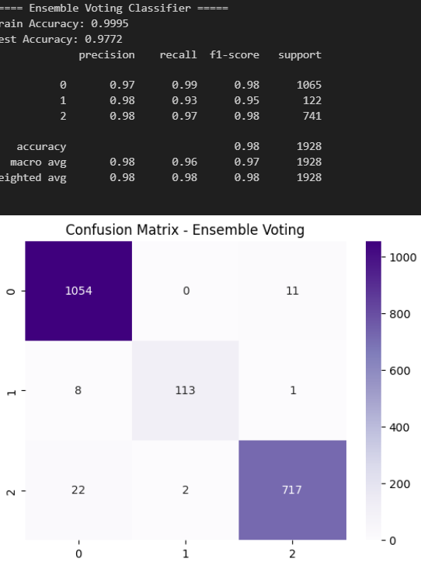
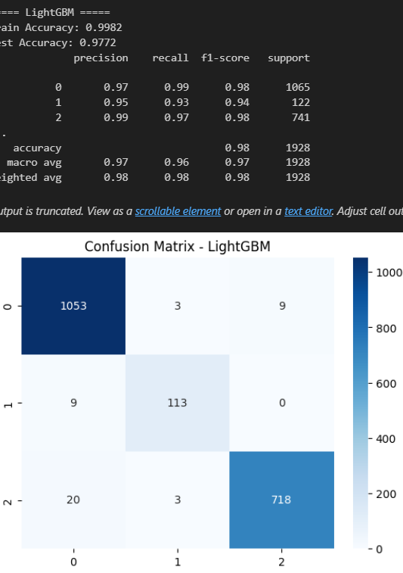
Both have similar results

Slide 23
comparison
Model | Train Accuracy | Test Accuracy | Precision (Weighted) | Recall (Weighted) | F1-Score (Weighted) | Macro Avg F1 | Conclusion
LightGBM | 0.9982 | 0.9772 | 0.98 | 0.98 | 0.98 | 0.97 | Best model, excellent accuracy and balanced performance.
Ensemble Voting Classifier | 0.9995 | 0.9772 | 0.98 | 0.98 | 0.98 | 0.97 | Almost identical to LightGBM, very strong performance.
XGBoost | 0.9996 | 0.9746 | 0.97 | 0.97 | 0.97 | 0.96 | High performance, but slightly behind LightGBM and Ensemble.
KNN | 0.8779 | 0.7287 | 0.76 | 0.73 | 0.74 | 0.64 | Moderate performance, struggles with Class 1 precision and recall.
Naive Bayes | 0.5769 | 0.6338 | 0.70 | 0.63 | 0.65 | 0.49 | Weak performance, particularly for Class 1, needs major improvements.

Slide 24
3. The third approach learning model with class-specific weight
It improves the performance by make the model pay more attention to underrepresented classes by assigning higher weights to misclassifications of theses classes

Slide 25
Model | Test Accuracy | Class 0 F1-Score | Class 1 F1-Score | Class 2 F1-Score | Overall Performance
LightGBM | 0.9756 | 0.98 | 0.95 | 0.97 | Best performance, balanced
XGBoost | 0.9746 | 0.98 | 0.95 | 0.97 | Best performance, balanced
Random Forest | 0.9689 | 0.97 | 0.93 | 0.97 | Strong, consistent
Decision Tree | 0.9398 | 0.94 | 0.85 | 0.94 | Good, solid performance
KNN | 0.7287 | 0.79 | 0.41 | 0.71 | Struggles with Class 1
Naive Bayes | 0.6338 | 0.76 | 0.16 | 0.56 | Weak on Class 1
Logistic Regression | 0.5462 | 0.48 | 0.01 | 0.62 | Low performance overall
SVM | 0.5441 | 0.45 | 0.32 | 0.62 | Poor performance overall

Slide 26
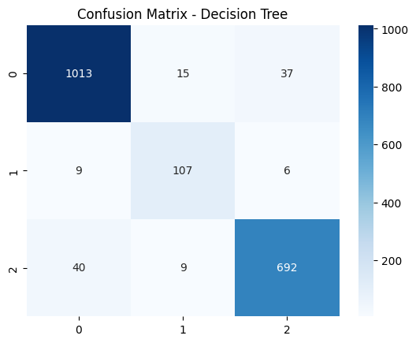
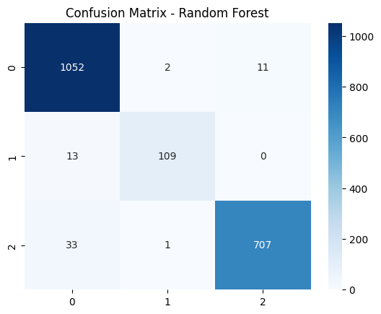
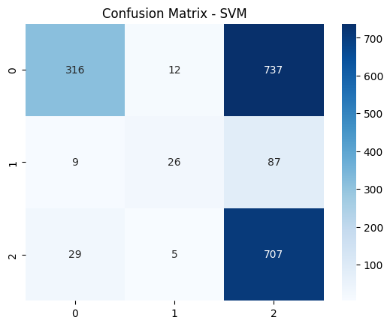
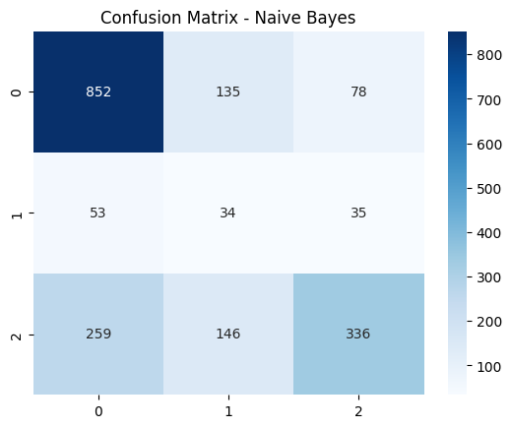

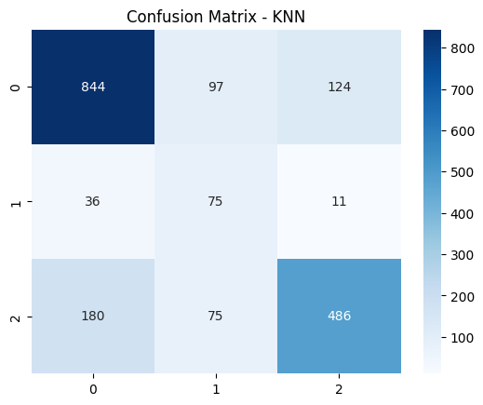

Slide 27
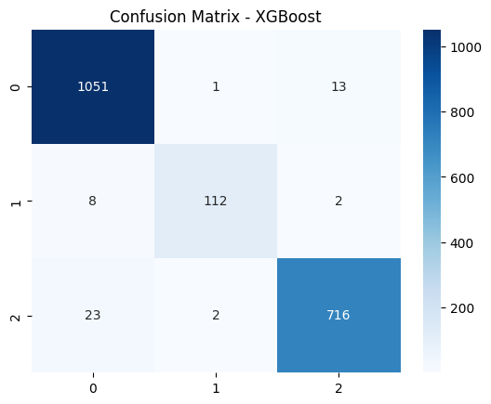
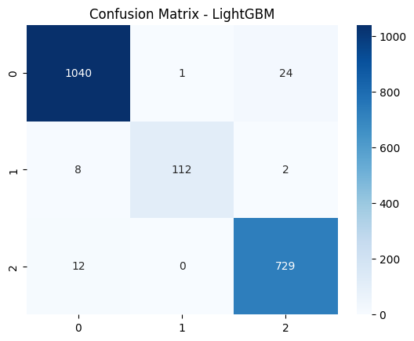

Slide 28
conclusion
After that we can say
If you notice abnormal about of hepatomegaly and spider vanes rush to the hospital
Stay healthy and a stay safe

Slide 29

conclusion
Best Performers: LightGBM and XGBoost
Mid-Range: Random Forest, Decision Tree
Lower Performers: KNN, Naive Bayes, Logistic Regression, SVM

